Slide 2
The game is designed to explore the concept of self-management in Scrum. It focuses on the three accountabilities in Scrum and that of the Leader. By playing the game, players will gain a better understanding of what self-management means and to identify patterns that emerge as they level up into maturity of each accountability.
Create a matrix where the vertical axis should represent the level of maturity, ranging from one to five. (Yellow cards) The horizontal axis should have the Scrum Master, Product Owner, Developer, and Leader. These are respectively the light blue, green, dark blue, purple cards.
Place the remaining accountabilities cards under the right column. To help you out, the color of the accountability cards should match that of the Scrum Master, Product Owner, Developer, and Leader.
Use the cheat sheet to check the results and have a conversation about self-management and the patterns that you see from level one till five.
All rights reserved Scrum.org. Original concept by RonEringa.com

Slide 3
Level 1

Slide 5
Level 2

Slide 7
Level 3

Slide 9
Level 4

Slide 11
Level 5

Slide 13


Scrum master

Slide 15
# 20
Facilitate
value
Plan & facilitates all Scrum events
Track progress & visualizes work
a
Scrum Master

Slide 16
# 20
Facilitate
value
Plan & facilitates all Scrum events
Track progress & visualizes work
B
Scrum Master

Slide 17
# 14
Facilitate
value
Facilitates the Scrum events
Enables the Developers to track & visualizes work
a
Scrum Master

Slide 18
# 14
Facilitate
value
Facilitates the Scrum events
Enables the Developers to track & visualizes work
B
Scrum Master

Slide 19
# 15
Facilitate
value
Help Scrum team by facilitating transparency, inspection & adaptation
Enables Product Owner to focus on value delivery
a
Scrum Master

Slide 20
# 15
Facilitate
value
Help Scrum team by facilitating transparency, inspection & adaptation
Enables Product Owner to focus on value delivery
B
Scrum Master

Slide 21
# 1
Facilitate
value
Help stakeholders understand & apply Agile principles
Focus on continuous improvements in the value chain
a
Scrum Master

Slide 22
# 1
Facilitate
value
Help stakeholders understand & apply Agile principles
Focus on continuous improvements in the value chain
B
Scrum Master

Slide 23
# 8
Facilitate
value
Help the organization to understand & apply Agile principles
Enables the organization to continuously have impact on customers
a
Scrum Master

Slide 24
# 8
Facilitate
value
Help the organization to understand & apply Agile principles
Enables the organization to continuously have impact on customers
B
Scrum Master

Slide 25

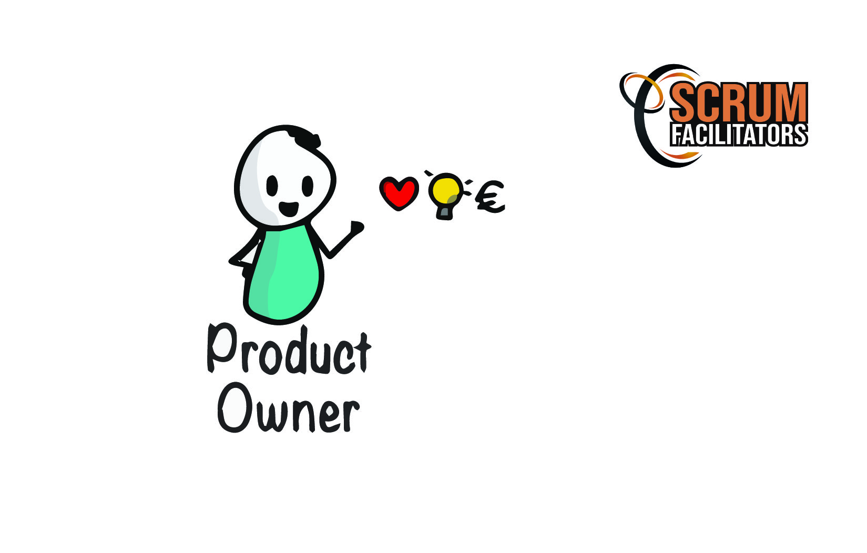
Product Owner

Slide 26


Slide 27
# 3
value
mandate
Focus on creating requirements & Product Backlog Items
Executes plans & decisions made by stakeholders
a
Product Owner

Slide 28
# 3
value
mandate
Focus on creating requirements & Product Backlog Items
Executes plans & decisions made by stakeholders
B
Product Owner

Slide 29
# 4
value
mandate
Focus on creating Sprint Goals & Product Increments
Has influence on stakeholders in making plans & Product related decisions
a
Product Owner

Slide 30
# 4
value
mandate
Focus on creating Sprint Goals & Product Increments
Has influence on stakeholders in making plans & Product related decisions
B
Product Owner

Slide 31
# 9
value
mandate
Focus on creating value & process
Collaborate with stakeholders to make plans & Product related decisions
a
Product Owner

Slide 32
# 9
value
mandate
Focus on creating value & process
Collaborate with stakeholders to make plans & Product related decisions
B
Product Owner

Slide 33
# 10
value
mandate
Focus on continuous value creation & stakeholder collaboration
Has mandate to make Product related decisions & release plans
a
Product Owner

Slide 34
# 10
value
mandate
Focus on continuous value creation & stakeholder collaboration
Has mandate to make Product related decisions & release plans
B
Product Owner

Slide 35
# 6
value
mandate
Focus on continuous value optimizing & customer collaboration
Is responsible for planning, budget, profits & loss of the products’ value chain
a
Product Owner

Slide 36
# 6
value
mandate
Focus on continuous value optimizing & customer collaboration
Is responsible for planning, budget, profits & loss of the products’ value chain
B
Product Owner

Slide 37

Developers

Slide 39
# 7
Self-managing
collaboration
Relying on the Scrum Master to facilitate them
Avoiding conflict / Pursuing individual targets / generating outputs
a
Developer

Slide 40
# 7
Self-managing
collaboration
Relying on the Scrum Master to facilitate them
Avoiding conflict / Pursuing individual targets / generating outputs
B
Developer

Slide 41
# 13
Self-managing
collaboration
Ensuring the outcome of all events & learning the Scrum Values
Discovering differences/ conflicts / shared values
a
Developer

Slide 42
# 13
Self-managing
collaboration
Ensuring the outcome of all events & learning the Scrum Values
Discovering differences/ conflicts / shared values
B
Developer

Slide 43
# 12
Self-managing
collaboration
Focused on reaching Sprint Goals & improving quality
Using Scrum & Agile principles as a guideline for all interactions
a
Developer

Slide 44
# 12
Self-managing
collaboration
Focused on reaching Sprint Goals & improving quality
Using Scrum & Agile principles as a guideline for all interactions
B
Developer

Slide 45
# 18
Self-managing
collaboration
Responsible & committed to continuously deliver valuable outcome
Collaborating with stakeholders to continuously adapt
a
Developer

Slide 46
# 18
Self-managing
collaboration
Responsible & committed to continuously deliver valuable outcome
Collaborating with stakeholders to continuously adapt
B
Developer

Slide 47
# 17
Self-managing
collaboration
Accountable or creating high quality Products
Collaborating with everyone to participate in sharing feedback & learning
a
Developer

Slide 48
# 17
Self-managing
collaboration
Accountable or creating high quality Products
Collaborating with everyone to participate in sharing feedback & learning
B
Developer

Slide 49

Leader

Slide 51
# 11
Delegation
measuring
Wants full control & has a directive communication style
Gives individual targets and measures on progress / efficiency/ quality & Outputs
a
Leader

Slide 52
# 11
Delegation
measuring
Wants full control & has a directive communication style
Gives individual targets and measures on progress / efficiency/ quality & Outputs
B
Leader

Slide 53
# 5
Delegation
measuring
Wants to be in control & delegates less critical responsibilities
Gives team(s) targets and measures on progress / efficiency / quality & outcomes
a
Leader

Slide 54
# 5
Delegation
measuring
Wants to be in control & delegates less critical responsibilities
Gives team(s) targets and measures on progress / efficiency / quality & outcomes
B
Leader

Slide 55
# 16
Delegation
measuring
Delegates more important responsibilities
Provides boundary conditions for teams to set their own targets
a
Leader

Slide 56
# 16
Delegation
measuring
Delegates more important responsibilities
Provides boundary conditions for teams to set their own targets
B
Leader

Slide 57
# 2
Delegation
measuring
Delegates all but critical decisions & responsibilities
Creates an environment where teams can self-manage & create value
a
Leader

Slide 58
# 2
Delegation
measuring
Delegates all but critical decisions & responsibilities
Creates an environment where teams can self-manage & create value
B
Leader

Slide 59
# 19
Delegation
measuring
Delegate all decisions & responsibilities
Facilitates entrepreneurship & growth for every employee
a
Leader

Slide 60
# 19
Delegation
measuring
Delegate all decisions & responsibilities
Facilitates entrepreneurship & growth for every employee
B
Leader

Slide 61
Scrum Master | Product Owner | Developer | Leader
8 | 6 | 17 | 19
1 | 10 | 18 | 2
15 | 9 | 12 | 16
14 | 4 | 13 | 5
20 | 3 | 7 | 11

